Slide 1

Chocolate
Como uma pequena semente se transforma no “Alimento dos Deuses"
M. Helena Guimarães de Almeida
        Instituto Superior de Agronomia
        Agronomia Tropical

Slide 2
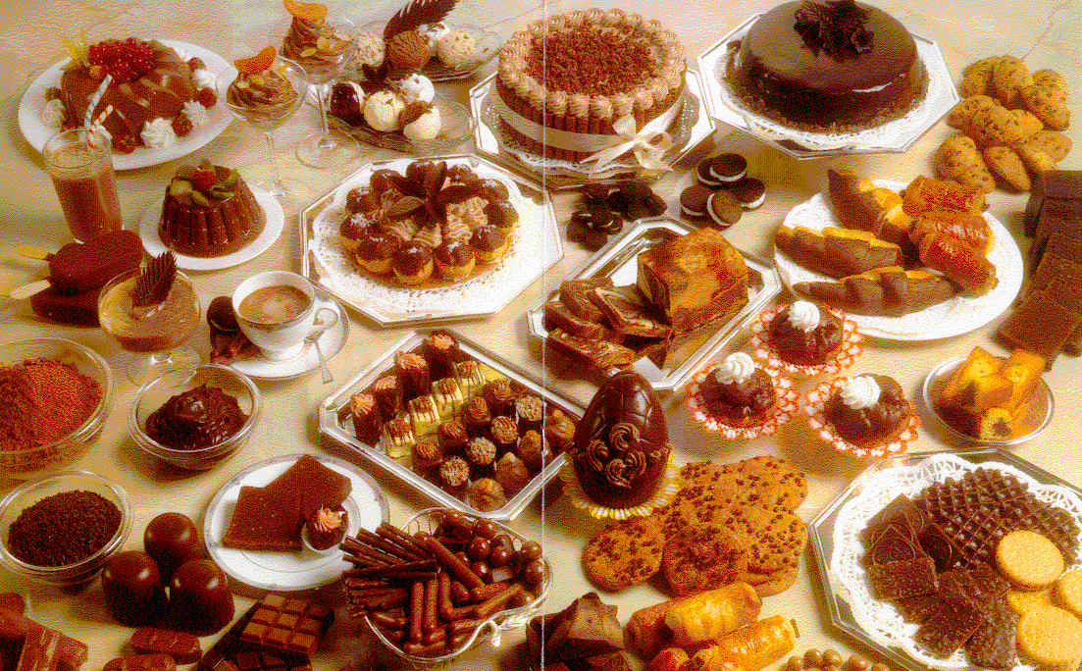

Slide 3
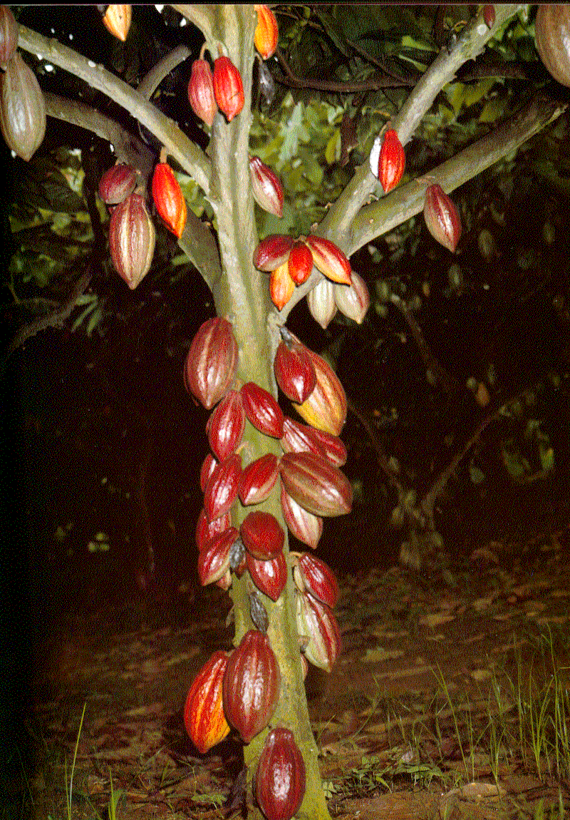
Cacaueiro

Slide 4
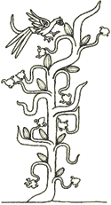
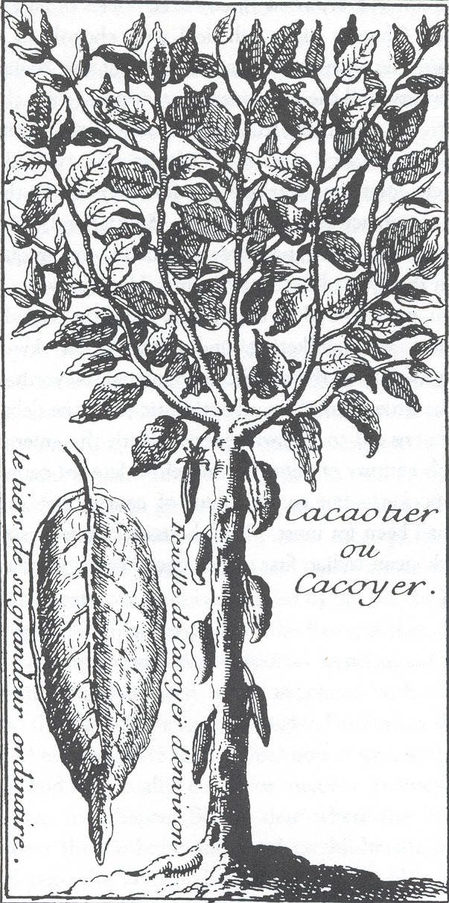
Alimento dos deuses
1753 • Classificação científica
Carolus Lineus: Theobroma cacao
Início séc. XVIII
Séc. IX

Slide 5
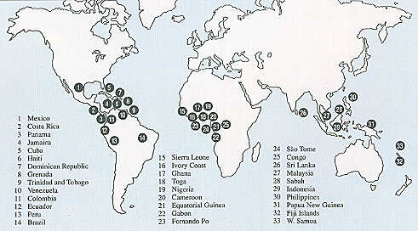
Produção de cacau no mundo

Slide 6
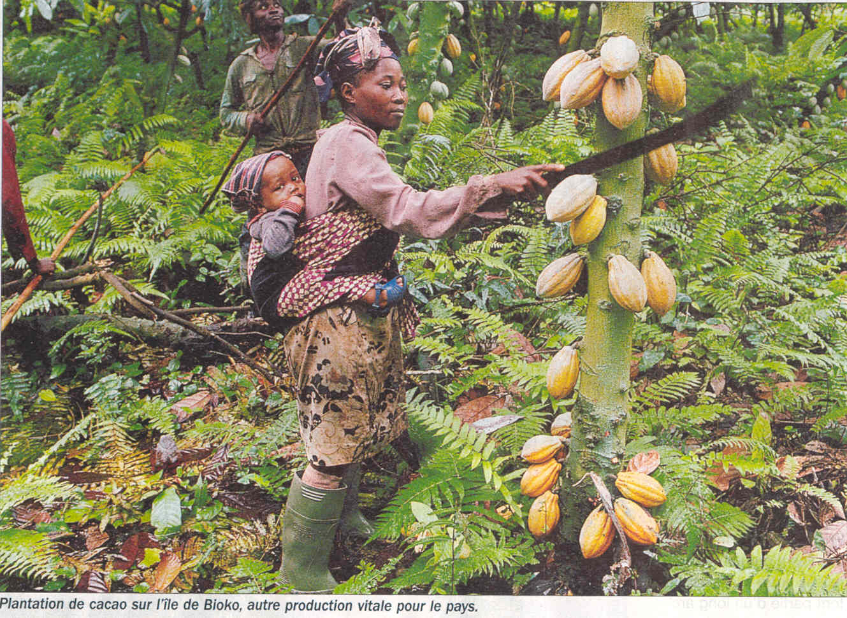
COLHEITA

Slide 7
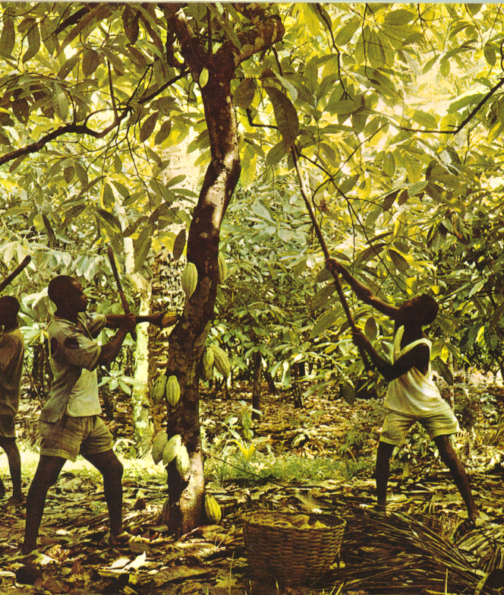
COLHEITA

Slide 8
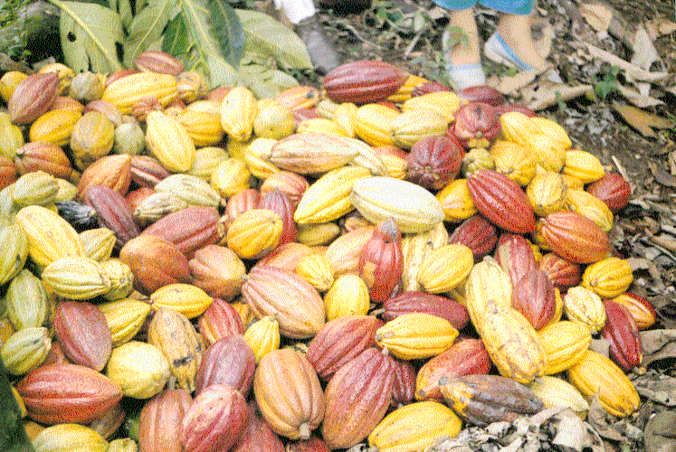
Frutos após colheita

Slide 9
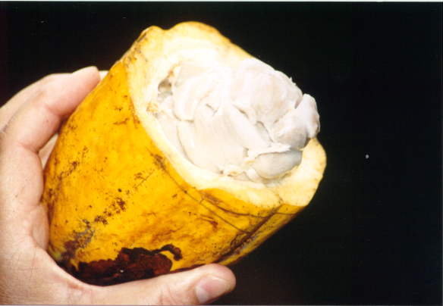
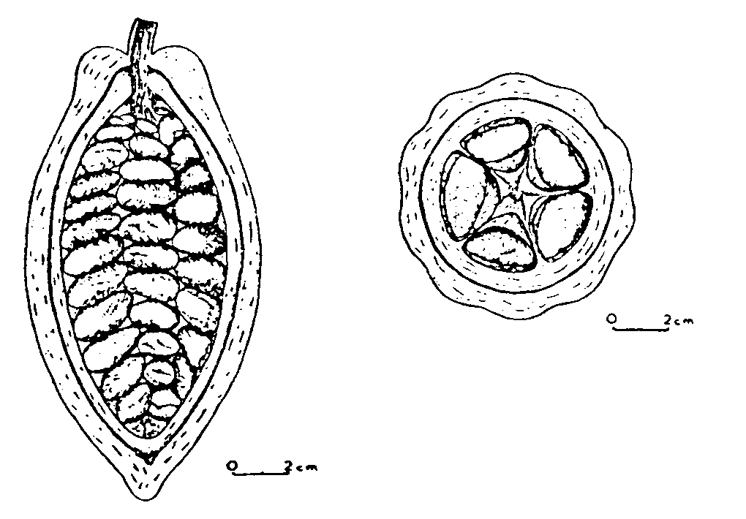
Fruto aberto

Slide 10
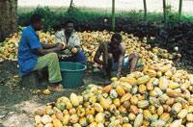
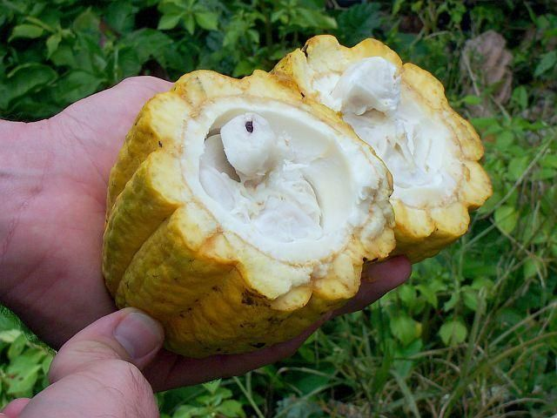
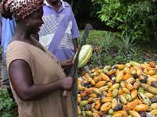
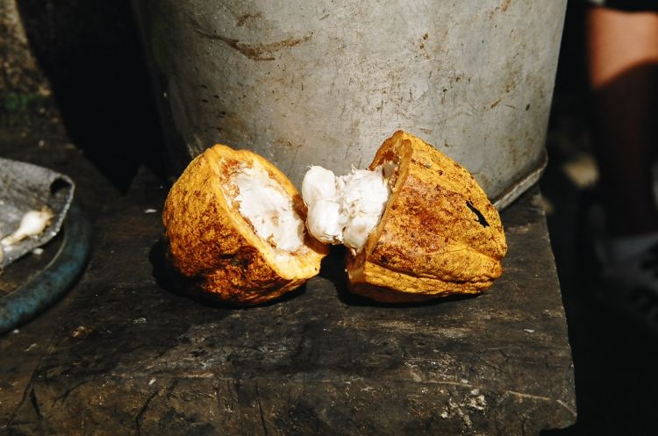
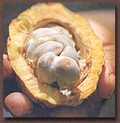

Slide 11
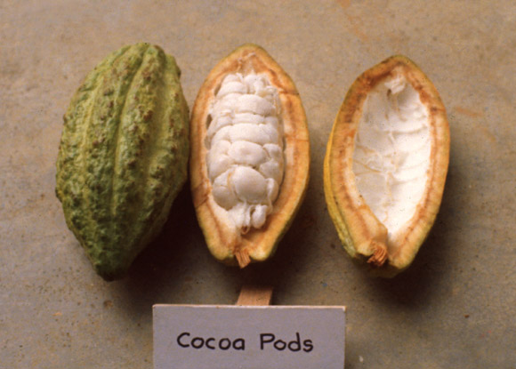
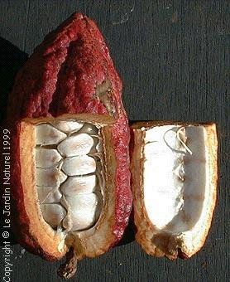
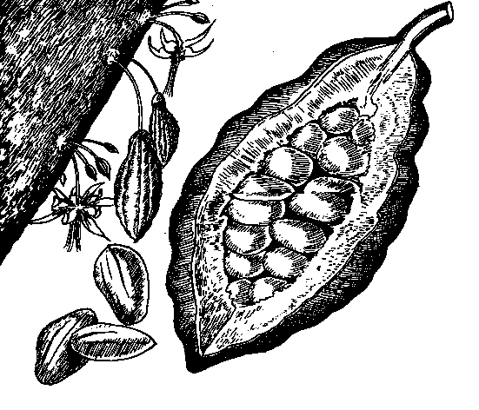

Slide 12
PREPARAÇÃO DO CACAU COMERCIAL
TECNOLOGIA PÓS-COLHEITA
COLHEITA
Frutos
QUEBRA
“Cascas”
“Cacau em goma”
“FERMENTAÇÃO”
SECAGEM
LIMPEZA, CALIBRAGEM E ARMAZENAMENTO
Cacau comercial

Slide 13
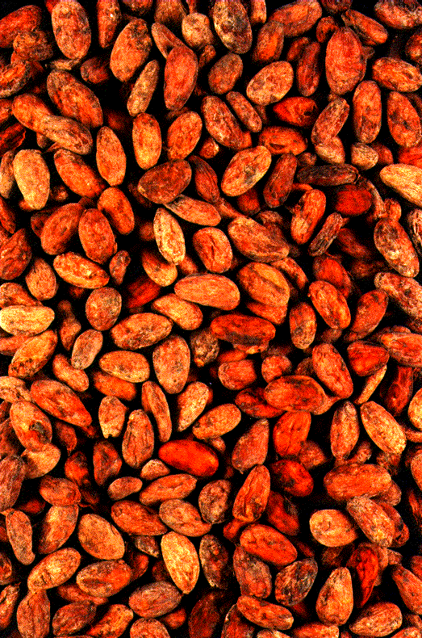
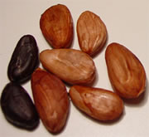
Cacau comercial

Slide 14
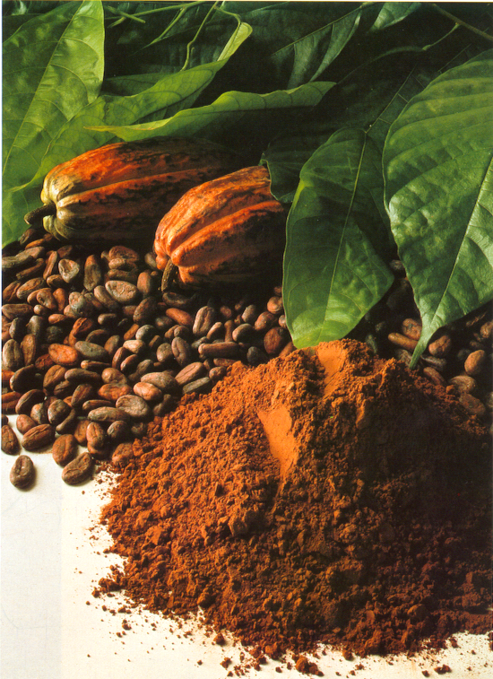
Cacau comercial
Cacau comercial
TORRA
TORRA
  MANTEIGA
  DE
  CACAU
  MANTEIGA
  DE
  CACAU
  CACAU EM PÓ
  CACAU EM PÓ
  CHOCOLATE
  CHOCOLATE

Slide 15
INDUSTRIALIZAÇÃO

Slide 16
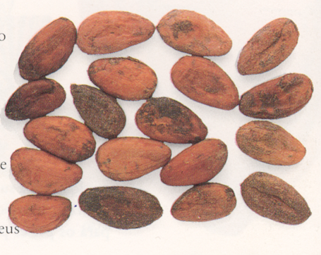
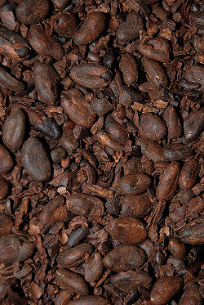
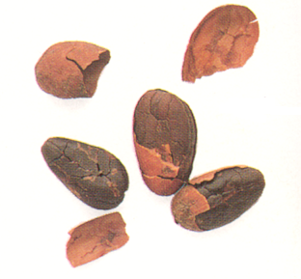
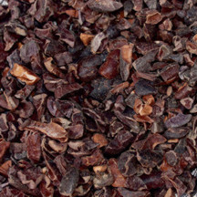
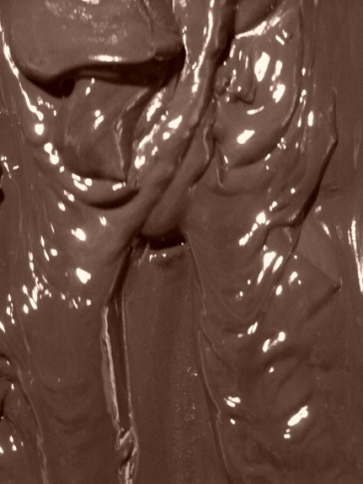
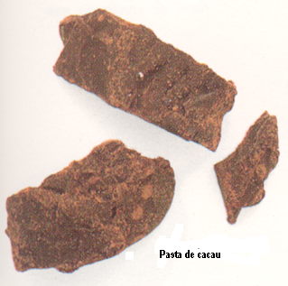
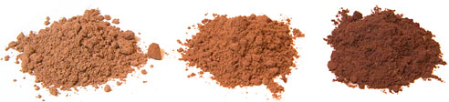
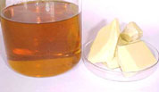
1.
2.
2.
4.
http://www.naturallygreen.co.uk
3.
6.
5.

Slide 17
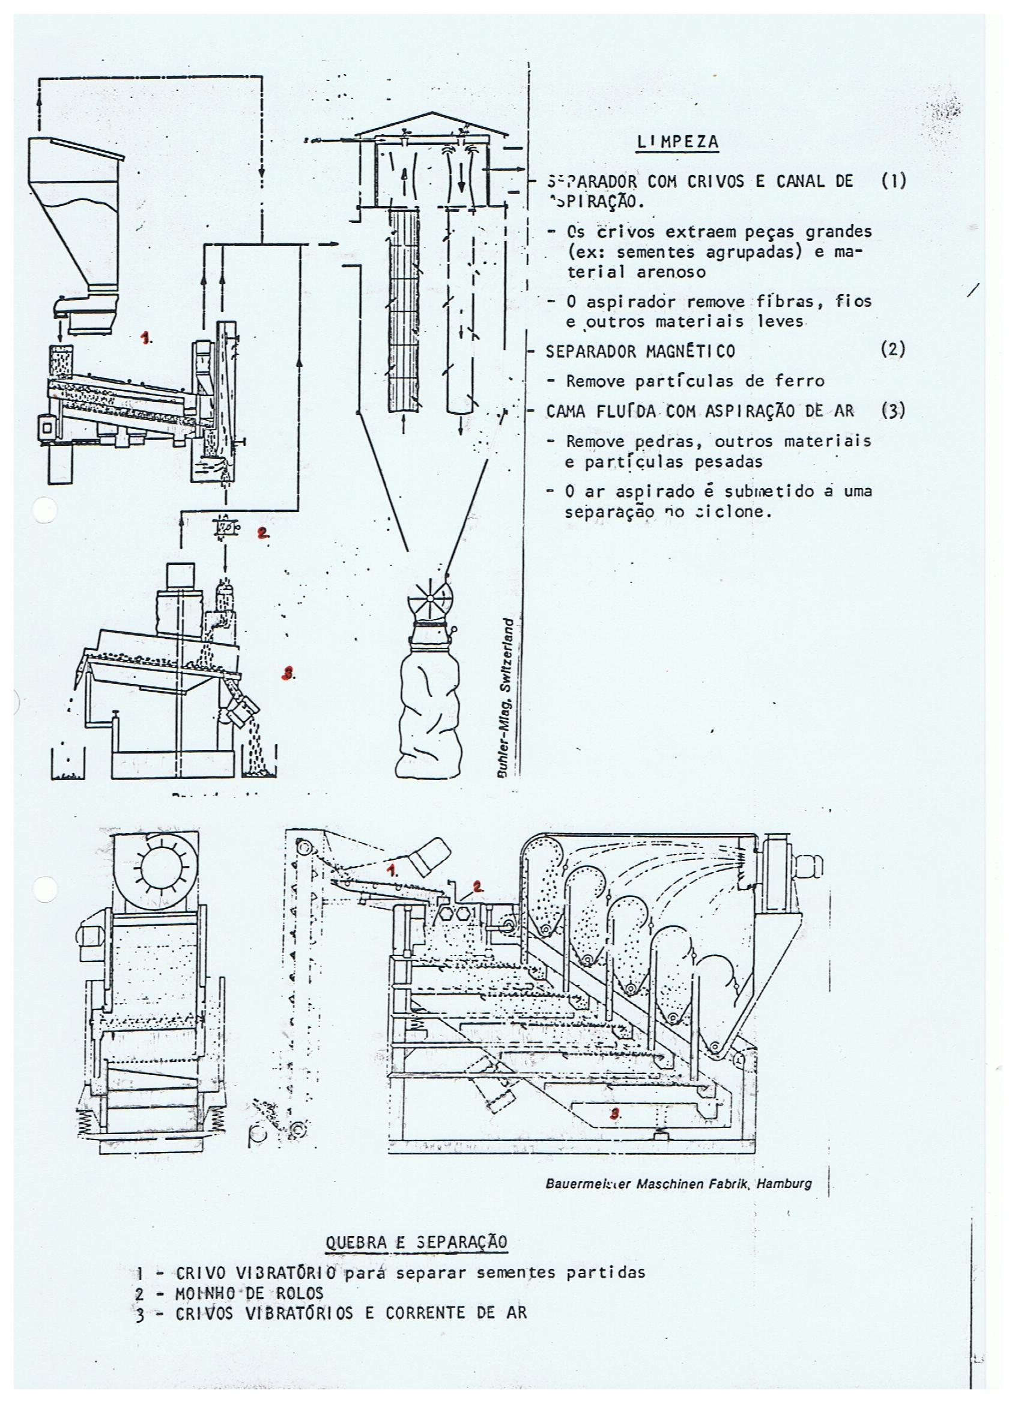

Slide 18
Types of Cocoa Bean Roasters
https://www.amanochocolate.com/articles/cocoaroasting-3.html
It is not hard to imagine that once in an Olmec village in Central America some cocoa beans were accidentally spilled near the fire, or some genius had the spark of inspiration to roast cocoa beans, an oversight that sent their culture and eventually the rest of the world on the chocolate journey that consumes us like the spark of the fire from that very first roast. In either case, the first cocoa beans were probably roasted on rocks alongside the fire, on a rock slab over the fire, or possibly in a clay pot. Whatever the original method of roasting, it created a legacy that lasts until today.
When cocoa beans were first brought to Europe, the method of roasting was quite simple, often consisting of no more than metal trays suspended by chains over a fire, an ancient Middle Eastern technique for roasting coffee. The beans would be stirred by hand with a long stick or paddle until the roast was complete. Needless to day, this was very labor intensive and inefficient. Clearly, something more efficient was needed.
The next development in roasting technology was not that far distant from roasters in use today. Metal cylinders or balls that could hold up to several pounds of cocoa beans would be suspended over the embers of a fire. A rod would run through the center and act as an axis upon which the roaster would turn. A hand crank on one end would allow the cylinder or ball to be turned while the beans were roasting. The result was a much more even roast than was before possible. Aspects of this technique remain in many of today’s roasters.

Slide 19
Ball Roasters
As mentioned, all roasters were one of the very first kinds of roaster: balls were simply suspended simply over a fire, the cocoa beans inside. Ball roasters remained one of the primary and traditional roasters for cocoa beans through the turn of the century and were constructed at least through the 1960’s. Later designs were pioneered by the company Sirocco. (Sirocco is named after the hot wind that travels up from the Sahara desert and heads north and may reach hurricane speeds by the time it reaches northern Africa, Spain and France.) The ball is encircled within a secondary chamber so that the hot air passes in between the ball and the outer chamber wall. This prevents the flames from impinging directly on the ball and makes it easier to over roast the beans.
.

Slide 20
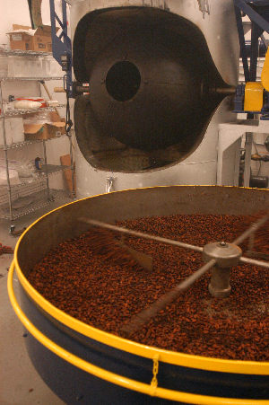
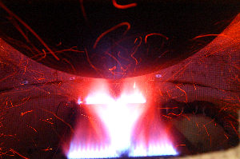
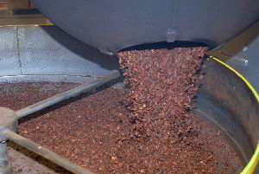
https://www.amanochocolate.com/articles/cocoaroasting-2.html

Slide 21
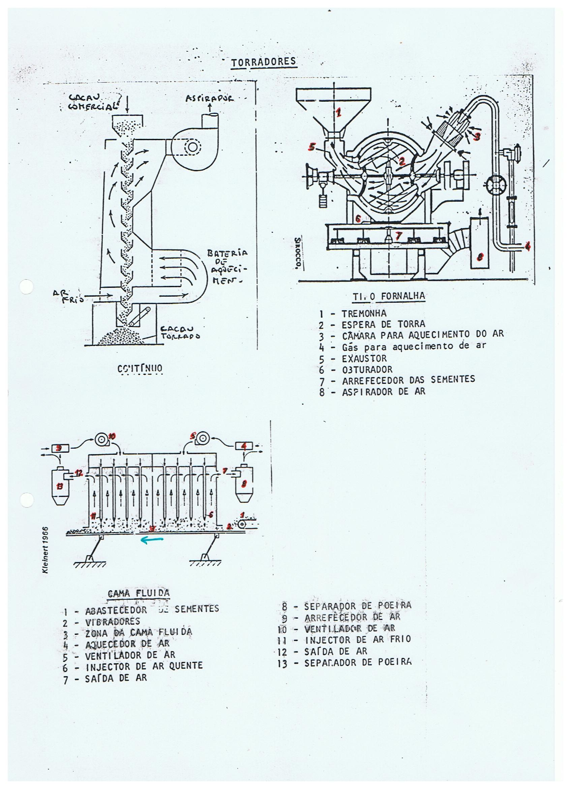
Today, ball roasters have been largely replaced by roasters of similar design that use a rotating cylinder rather than a rotating ball. There are a number of practical advantages of this design, since the shape of a cylinder with two ends makes it easier for samples to be removed. It also allows for easier measurement of the temperature of the beans if automation is a requirement. Ball roasters still hold advantage when flavor is of paramount importance

Slide 22
Continuous Roasters
The large chocolate manufacturers rely on continuous roasters. Given the quantity of beans that must be roasted for a large industrial chocolate manufacturer and the relatively low prices of industrial chocolate, they are probably one of the only economical ways to roast the large quantity of beans that must be roasted.
There are many different styles of continuous roaster, though in general they fall into two different categories. In one style, the beans are passed on a conveyer belt through a roasting tunnel. The degree of roast can be controlled by controlling the temperature in the tunnel as well as the speed of the conveyer belt. The heat is applied to the beans in a consistent way throughout the roasting process. Alternatively, another style uses a tall tower into which the beans are fed into the top. The tower has a series of trays upon which the beans rest. Once the beans have roasted on one tray for a given period of time, they are dumped onto the next tray. By the time the beans reach the bottom of the tower, they are fully roasted. The airflow through the tower is from the bottom up. The beans cool the air as the air passes them, at the same time heating the beans. This means that the beans on the lower levels are heated faster than those at the top. Because of this, they will generate a different flavor profile in the finished chocolate. It should be pointed out that there are also continuous fluid-bed roasters.
One disadvantage of this kind of roaster is that it is relatively difficult to pull samples of the beans from the roaster while they are being roasted. Furthermore, if the beans are found to be properly roasted when they are only partially through the roaster, there is no way to quickly remove them from the roaster and get them into a cooler. On the other hand, the large industrial chocolate makers run such large quantities of beans, this process can be fine tuned for a particular type of bean. Furthermore, most of these manufacturers use Forestero beans almost exclusively, for which the degree of roast is not as critical as it is with Criollo and other types of high-grade flavor beans.

Slide 23
Fluid Bed Roasters
Fluid bed roasters are a relatively new development. There are a number of different designs, some of them radically different. What they all have in common is that air is blown up through the beans, suspending them at least temporarily in air. The bottom of the roaster may vibrate to help launch the beans into the air. Fluid-bed roasters are typically used in large industrial environments, since they are conducive to short, high-temperature roasting that allows large volumes of beans to be roasted in a short period of time.

Slide 24
Cocoa Mass Roasters
These have already been discussed, but to recap, cocoa mass roasters are basically tanks in which the ground cocoa bean paste (cocoa mass) is heated as it is stirred until the desired level of roast is reached. It may also be implemented as a large heated cylinder where the cocoa mass is spread in a thin film. Since the film is thin, it roasts very quickly, and a thin knife blade scrapes it off of the far side of the cylinder. Cocoa-mass roasters are used by the large industrial chocolate manufacturers as a way to quickly roast large quantities of cocoa beans with minimal labor, since it is also a process that by nature requires little labor, and it also lends itself to easy automation.

Slide 25
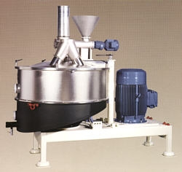
Moenda granulado

Slide 26
We won’t get into the many other roasting technologies, such as infrared and microwave. There are even combinations of the various kinds, such as continuous fluid bed roasters. No matter the technology, the best roaster is the one best suited to the job. With poor quality beans, cocoa mass roasters and continuous roasters, or even coffee roasters, will often suffice, since the beans’ flavors are already considerably damaged; no matter the care, the lost flavors may not be brought back. However, if fine flavor is to be developed in the finished chocolate, the choice of roaster is much more critical, as are the techniques used to roast the cocoa beans. Different beans and different styles of chocolate have different roasting requirements, so care must be taken to select the roaster that will best bring the final result, be it high production quantity, as is the case for the large industrial manufacturers, or fine flavor for the artisanal chocolate makers.

Slide 27
Conclusion
Roasting truly is one of the chocolate maker’s arts. It takes a fine flavor palate to be able to judge a roast and judge how the roasted cocoa bean will taste when it is turned into fine chocolate. An incredible number of flavor changes occur during the time the cocoa beans are roasted. Even after the chocolate is complete—even as the chocolate is “resting” and undergoing its final stages of flavor development—the flavors continue to change. The resting process continues oftentimes for several months. The chocolate maker who seeks for optimal flavor must not only think about the flavor of the bean as it is being roasted but must think about how the flavors will change as the chocolate is being made and how the chocolate will taste after it has rested. The flavors will be radically different, and new flavor profiles will often express themselves. Roasting is a bit of a secret art. There are no guidelines on how the best cocoa roasts are to be obtained. It must be learned through experience and through many tests and trials—many of which result in failure. However, this is the case with most all great artistic skills, and the cocoa bean roaster is truly an artist—an artist in flavor. The roaster is an artist who uses one of the world’s greatest sources of flavor and noblest of ingredients—the cocoa bean, also known as “the food of the gods.”

Slide 29
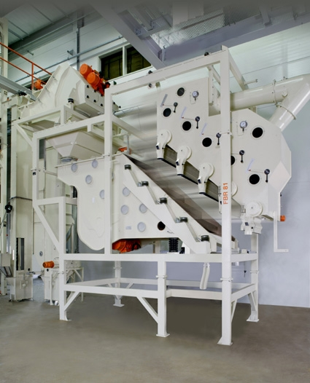
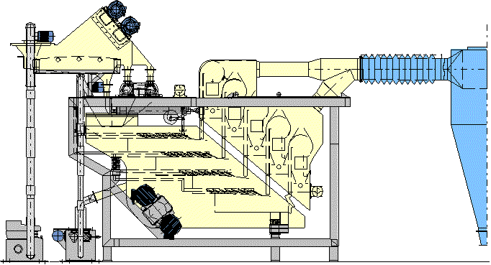

Slide 30
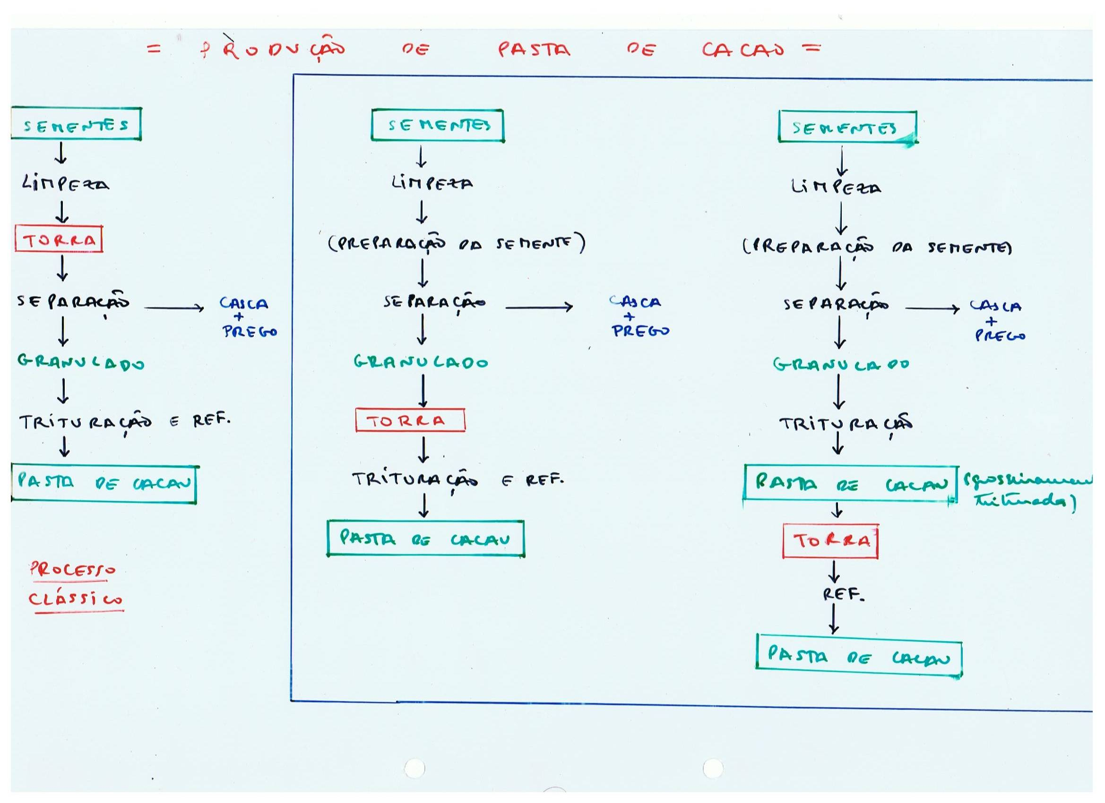

Slide 31
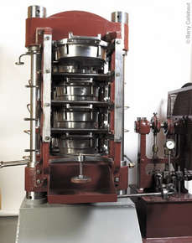
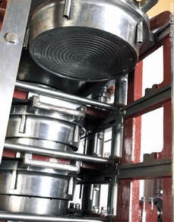
Prensa de Van Holten

Slide 32
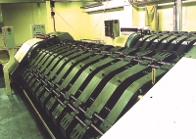
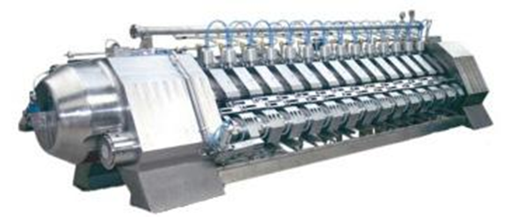
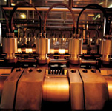
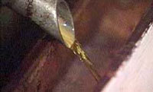
Prensa de espressão

Slide 33
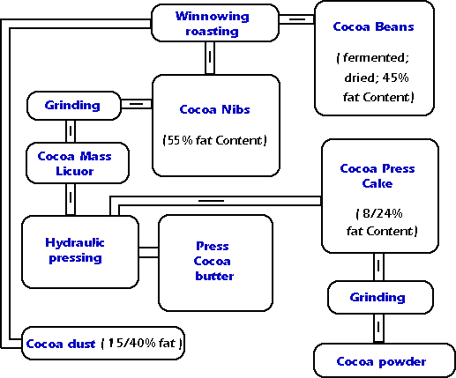
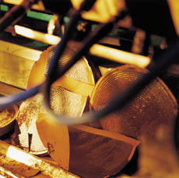
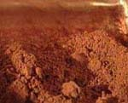
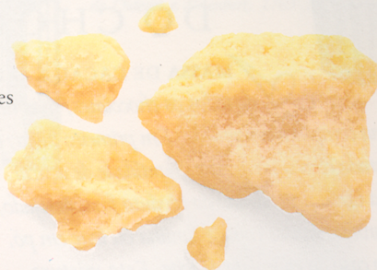

Slide 34
Dagoba organic, Scharffen-Berger, and Valrhona (dutch-processed) cocoa powders.

Slide 35
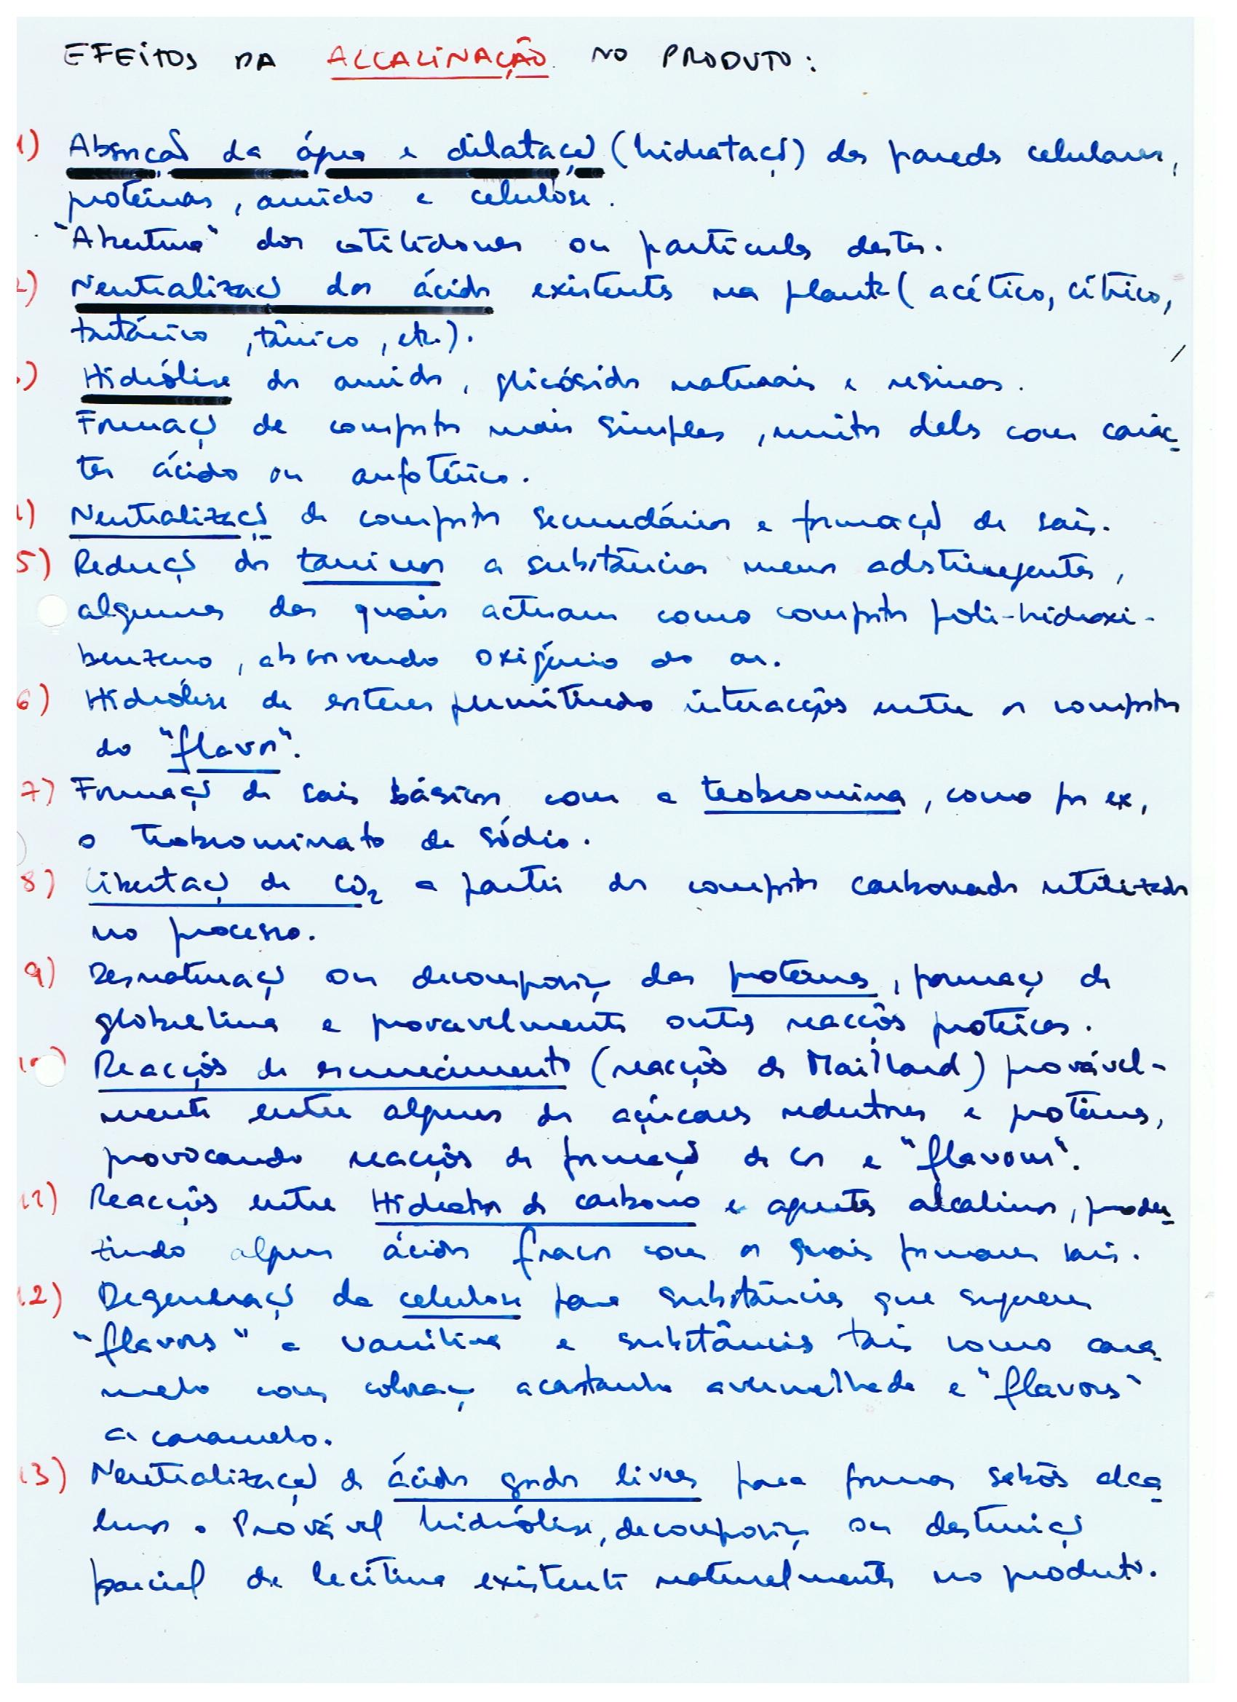

Slide 36
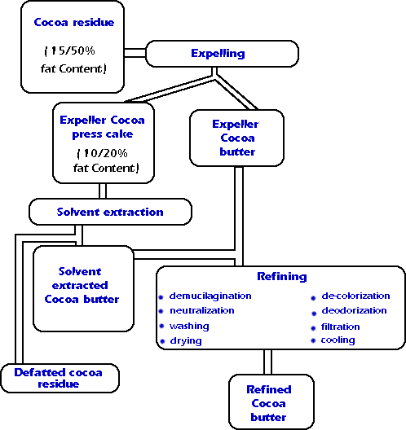

Slide 37


Slide 38




Slide 39


Slide 40


Slide 41


Slide 42


Slide 43


Slide 44


Slide 45


Slide 46


Slide 47


Slide 48

Produção Clássica do Chocolate
Leite
Açúcar
Pasta de cacau
Mistura
Lecitina
Refinação
Manteiga de cacau
Conchagem
Temperagem
Moldagem
Chocolate

Slide 49






https://thechocolatelife.com/thechocolatelifelive-bhavani-v-diamond-custom-machines/

Slide 50


Slide 51


Confocal micrograph of milk showing milk protein (green), fat (blue), sugar crystals (black) and cocoa solids (red). Bar = 25 mm

Slide 52



lecitina

Slide 53


Slide 54

https://www.javachocolates.com.br/pra-que-serve-lecitina-de-soja/

Slide 55
Explicação científica e acessível do efeito dos emulsionantes no fabrico do chocolate:
https://chocolatealchemy.com/blog/2018/12/17/ask-the-alchemist-263

Slide 56



1879 • A invenção do chocolate de leite
1867 - Henri Nestlé conseque produzir leite em pó.
1879 – Daniel Peter produz as primeiras tabletes de chocolate de leite.

Slide 57


Slide 58

Refining involves the crushing and shearing of cocoa and sugar particles to produce a product with the desired particle size. Chocolate for the UK or USA markets should be refined to an average particle size of between 20µm m and 30µm, whereas European tastes demand a lower size range of 15µm to 22µm, which gives a smoother product.

Slide 59

1883

Slide 60


https://www.camargomaquinas.com.br/refinador-5-rolos/

Slide 61


Slide 62


Slide 63



Refinador 5 rolos
http://www.gutenberg.org/files/19073/19073-h/images/image086.jpg

Slide 64

https://www.cacaochocolade.nl/main.php?lng=5&p=inhoud&h=5&g=1&s=4&z=0&sp=

Slide 66


1879 • Rudolphe Lindt inventa a conchagem.

Slide 67


CONCHA HORIZONTAL
http://www.gutenberg.org/files/19073/19073-h/19073-h.htm#image80

Slide 68


Slide 69





Slide 70




Slide 72


CONCHE
CLOVER 30-60
http://www.carle-montanari.eu/System/00/01/34/13488/ed_itIT/clover_i.pdf

Slide 73

CONCHA ROTATIVA
http://www.carle-montanari.eu/System/00/01/34/13488/ed_itIT/clover_i.pdf

Slide 74

Conching is used to develop flavour and to remove undesirable volatile components (e.g. acetic acid), produced during the fermentation of the cocoa beans. The duration of conching is an important factor because most of the flavour changes occur within the first 24 hours. Likewise the temperature at which conching takes place is important, in order to achieve the desired taste/texture. For example, milk chocolate should be conched at 45° to 60°C, whereas plain chocolate should be conched at 55° to 85°C for British taste and up to 100°C for European tastes.

Slide 75


Slide 76


Slide 77





Fases da conchagem

Slide 78


conchagem
antes
durante

Slide 79


Slide 80
CONCHA ROTATIVA
http://www.carle-montanari.eu/System/00/01/34/13488/ed_itIT/clover_i.pdf

Slide 81

https://www.findingfinechocolate.com/2014/02/how-does-conch-time-impact-chocolate.html

Slide 82


1908 • Jean Tobler inventa a temperagem .

Slide 83


Slide 84




Slide 85




Slide 86



Slide 87



Com temperagem
Fat bloom
sem temperagem

Slide 88


Slide 89

Legend
1 - Holding tank
2 - Chocolat feed pump
3 - Chocolate temperature indicator
4 - K&KURT temper machine(KTM)
5 - Coating machine (Enrober)
6 - Circulation pump
7 - Curtain trough
8 - Return pump
9 - Detempering heat exchanger
10 - Vibratory sieve
11 - Moulding machine (Depositor)
12 - Dual depositing head
13 - Automatic feed valve
14 - Supply of chocolate
Moulding Plant

Slide 90






Slide 91


Slide 93


Slide 94




Slide 95

http://www.carle-montanari.eu/Default.aspx?LN=it-IT

Slide 96




http://www.carle-montanari.eu/Default.aspx?LN=it-IT

Slide 97


Slide 99

1-Amêndoa de cacau, 2-Descarregamento, 3-Classificador, 4-Moagem, 5-Tanque depósito, 6-Secador, 7-Peneiramento, 8-Torrador, 9-Resfriamento, 10-Pré-Moagem (grossa), 11-Moagem fina, 12-Refinação, 13-Peneiramento, 14-Liquor de cacau (massa liquida), 15-Temperagem do liquor, 16-Torta de cacau final, 17-Prensa, 18-Torta de cacau, 19-Manteiga de cacau, 20-Filtro, 21-Misturador, 22-Tanque depósito, 23-Classificador, 24-Desodorização da manteiga de cacau, 25-Secador de leito fluidizado, 26-Temperagem, 27-Cacau em pó final, 28-Tratamento da manteiga, 29-Manteiga de cacau final.
Figura-5: Fluxograma do processo de produção de cacau
http://tecalim.vilabol.uol.com.br/cacauchocolate.html

Slide 101


